Slide 1

WAY TO ENTERPRISE
Application Delivery Controller
- Git
VTI ACADEMY
Author: namviet0710@gmail.com
February 2024

Slide 2
Agenda
Application Delivery Controller
Git
Copyright © VTI Academy All Rights Reserved

Slide 3
WAY TO ENTERPRISE
Application Delivery Controller

Slide 4
Caching Server
Function:
                A caching server stores copies of frequently requested content or data close to the clients that use them. By temporarily storing this data, caching servers reduce the need for repetitive access to backend servers, thereby speeding up response times and reducing bandwidth usage.
Benefits:
Reduced Latency: Caching allows for faster retrieval of data by serving it directly from the cache, reducing the time taken to fetch it from the original server.
Bandwidth Savings: By serving cached content, it minimizes the amount of data that needs to travel across the network.
Improved Load Management: It alleviates the load on backend servers, allowing them to handle more requests or perform other functions more effectively.
Enhanced User Experience: Faster access to content leads to a better user experience, which is critical for high-traffic websites and applications.

Slide 5
Caching Server
Example:
Web Content Caching: When users request a webpage, the caching server saves a copy. Subsequent requests for the same page are served from the cache, which is significantly faster than generating the page from scratch every time.
Tools:
Redis:
Description: Redis is an in-memory data structure store, often used as a distributed cache. It supports various data structures and provides high-performance storage for frequently accessed data.
Use Case: Widely used for caching database queries, session management, and real-time data analytics.
Varnish Cache:
Description: Varnish is a web application accelerator or HTTP reverse proxy. It is designed for content-heavy dynamic web sites as well as APIs. Varnish can cache content in memory, significantly speeding up response times for web pages.
Use Case: Often used by large media companies and e-commerce sites to deliver content quickly and reduce load on origin servers.

Slide 6
Load Balancer
Function:
A load balancer distributes incoming network or application traffic across multiple servers or resources to ensure no single server becomes overwhelmed. This helps maintain system reliability and enhances the overall performance of applications.
Types of Load Balancing:
Round Robin: Distributes requests sequentially across all servers.
Least Connections: Directs traffic to the server with the fewest active connections.
IP Hash: Routes traffic based on the IP address of the client, ensuring the same client always connects to the same server.
Benefits:
Scalability: Allows systems to handle increased traffic by distributing the load evenly across multiple servers.
High Availability: Ensures continuous availability of applications by redirecting traffic from failed or overloaded servers to healthy ones.
Optimized Resource Utilization: Balances the load efficiently, preventing any single server from becoming a bottleneck.

Slide 7
Load Balancer
Example:
Web Servers Load Balancing: In a high-traffic scenario, a load balancer directs requests to a pool of web servers, distributing the load evenly to prevent any server from becoming overwhelmed.
Tools:
HAProxy:
Description: HAProxy is a reliable, high-performance load balancer and proxy server for TCP and HTTP applications. It is open-source and widely used in production environments.
Use Case: Suitable for large-scale web services and applications requiring high availability and efficient load distribution.
NGINX:
Description: NGINX, initially developed as a web server, also functions as a load balancer and reverse proxy. It excels in handling many concurrent connections with low resource usage.
Use Case: Used for load balancing in high-traffic web applications and services.

Slide 8
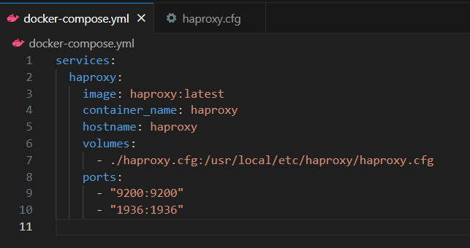
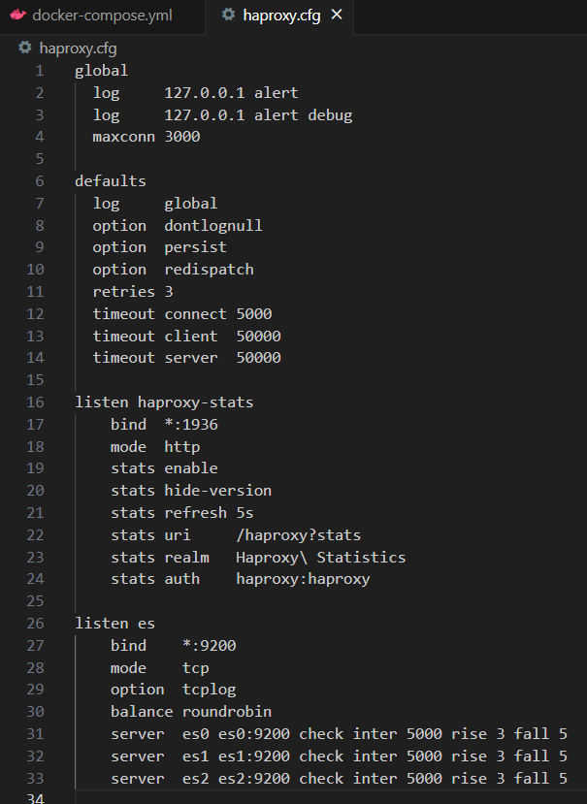
Load Balancer – HA Proxy
In this example, I create a HAProxy docker container which working as a Load Balancer for 3 Elastic nodes.
All of the config is written in 1936 haproxy.cfg file, then mount to the container.
Port 1936 is used for the HAProxy statistics page, which provides a web-based dashboard for monitoring the status of HAProxy and the backends it manages.
Port 9200 is port of Elastic nodes.
es0, es1, es2 is the names of 3 Elastic docker containers.

Slide 9
Reverse Proxy
Function:
A reverse proxy acts as an intermediary between clients and backend servers. It forwards client requests to the appropriate server and then returns the server's response to the client. This helps protect servers from direct exposure to the internet, enhance security, and balance the load.
Benefits:
Security: By masking the backend servers, a reverse proxy can protect them from direct attacks and handle SSL/TLS termination to offload encryption processing.
Load Balancing: It can distribute incoming traffic to multiple servers, ensuring efficient use of resources and improved performance.
Content Compression and Caching: It can compress outgoing responses and cache them, reducing bandwidth usage and speeding up response times.
Simplified Client Configuration: Clients only need to interact with the reverse proxy, not the actual servers, simplifying network configurations.

Slide 10
Reverse Proxy
Example:
Web Application Firewall (WAF): A reverse proxy can inspect incoming traffic for malicious activity before it reaches the backend servers, enhancing the security of web applications.
Tools:
Nginx:
Description: In addition to being a web server and load balancer, NGINX is commonly used as a reverse proxy server. It forwards client requests to backend servers and handles tasks like SSL termination and load balancing.
Use Case: Ideal for improving security and performance by acting as an intermediary between clients and backend servers
.
Apache HTTP Server (mod_proxy):
Description: Apache HTTP Server can be configured as a reverse proxy using the mod_proxy module. It supports HTTP, HTTPS, and FTP protocols and can forward requests to other servers.
Use Case: Useful for managing complex web applications and distributing requests among multiple backend servers.

Slide 11
Monitor Server
Function:
A monitor server continuously checks the health, performance, and availability of applications and services. It provides real-time insights and alerts about the system’s status, helping administrators ensure smooth operations and quickly address issues.
Benefits:
Proactive Issue Detection: Continuous monitoring allows for the early detection of problems, often before they impact end users.
Performance Optimization: By analyzing performance metrics, administrators can optimize resource usage and application performance.
Service Availability: Monitoring helps ensure that services remain available and can quickly alert administrators to any outages or disruptions.
Detailed Analytics: Provides valuable data on application usage, traffic patterns, and system performance, which can inform capacity planning and optimization efforts.

Slide 12
Monitor Server
Example:
Health Checks: Monitor servers can regularly ping backend servers or send test requests to ensure they are responsive. If a server fails to respond, the monitor server can alert administrators or trigger automated failover processes.
Tools:
Prometheus:
Description: Prometheus is an open-source monitoring and alerting toolkit designed for reliability and scalability. It collects and stores metrics as time series data, providing powerful querying capabilities.
Use Case: Widely used for monitoring cloud-native applications, Kubernetes clusters, and microservices architectures.
Nagios:
Description: Nagios is a robust, flexible monitoring system that provides alerts on server performance, uptime, and network health. It supports extensive plugins and integrations.
Use Case: Commonly deployed in enterprise environments to monitor complex IT infrastructures.

Slide 13
WAY TO ENTERPRISE
Git

Slide 14
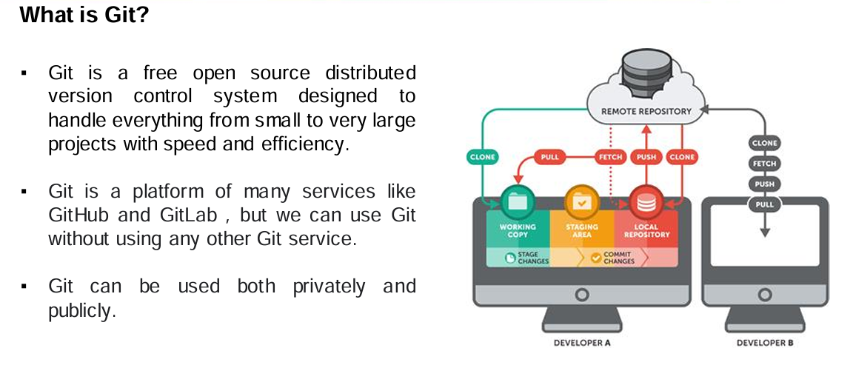
Git Introduction

Slide 15
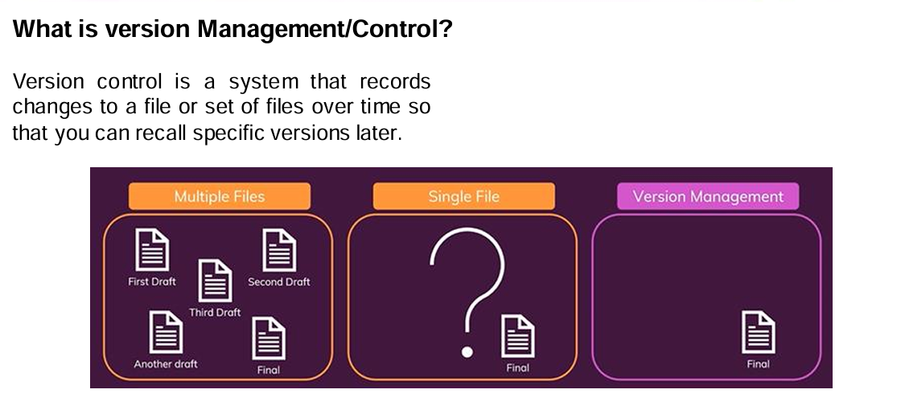
Git Introduction

Slide 16
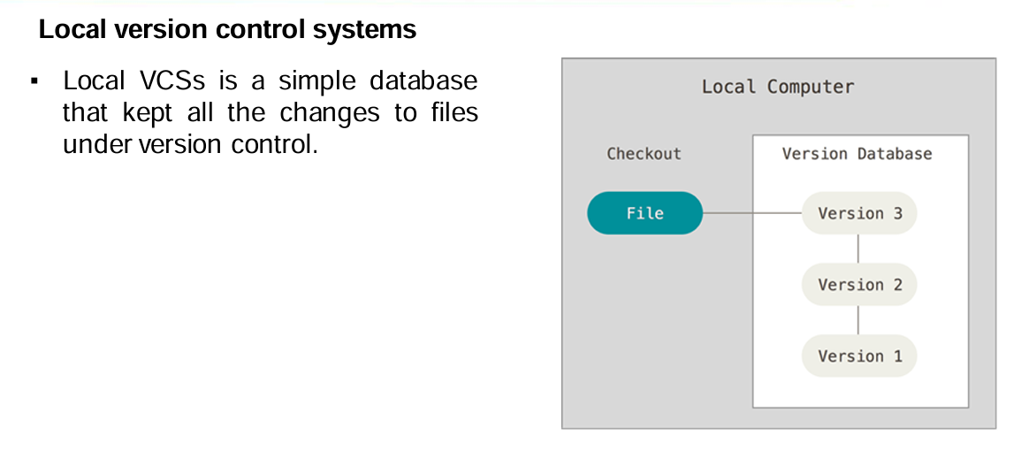
Git Introduction

Slide 17
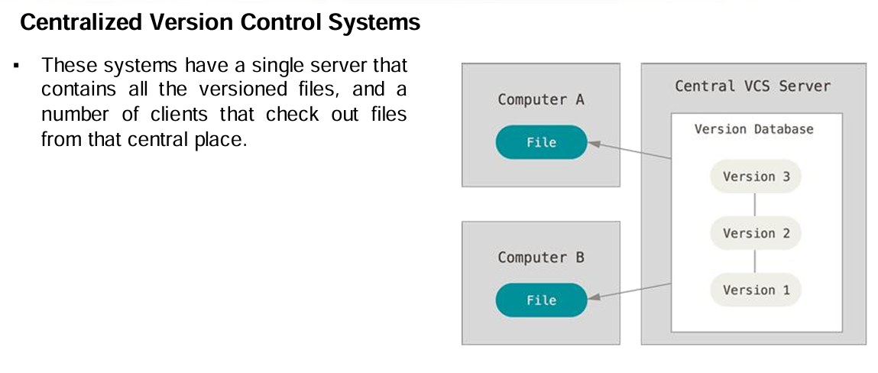
Git Introduction

Slide 18
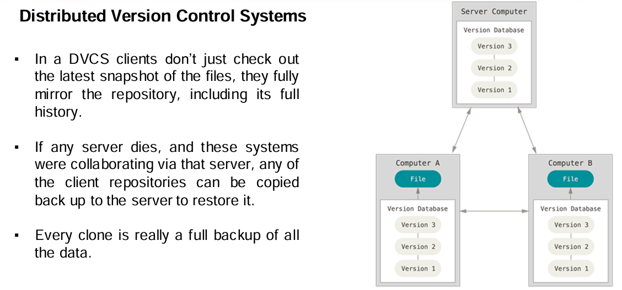
Git Introduction

Slide 19
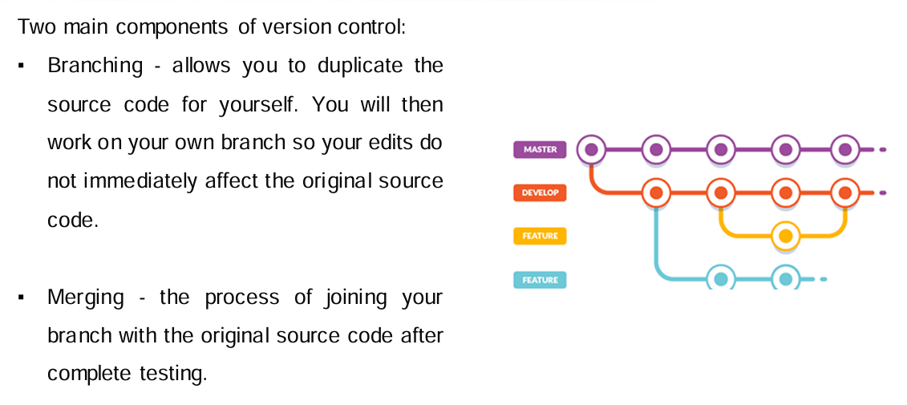
Git Introduction

Slide 20
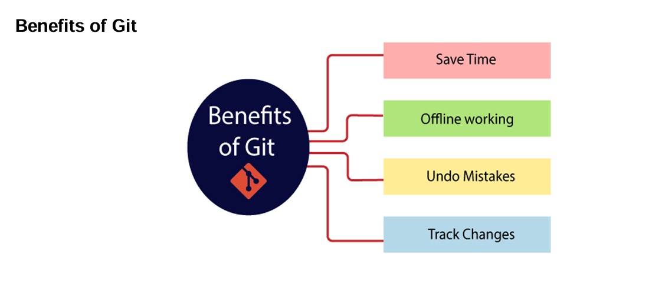
Git Introduction

Slide 21
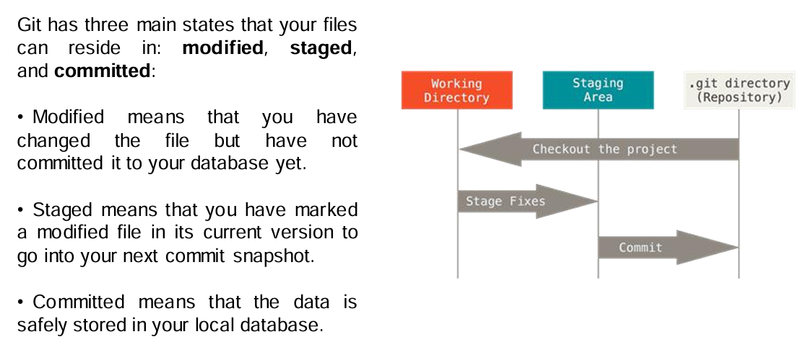
Git Introduction

Slide 22
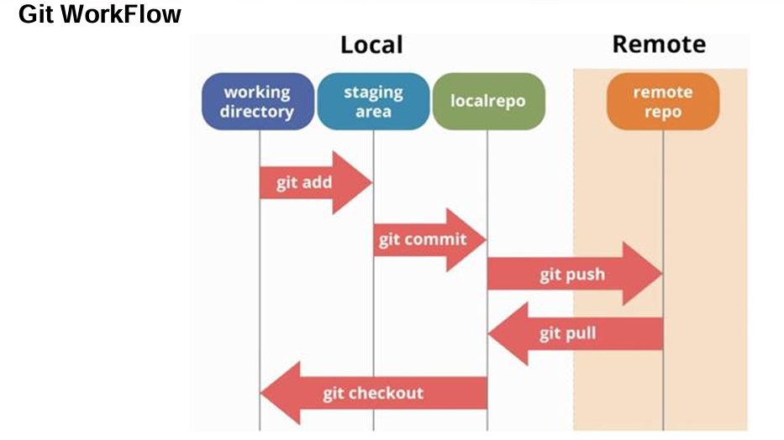
Git Introduction

Slide 23
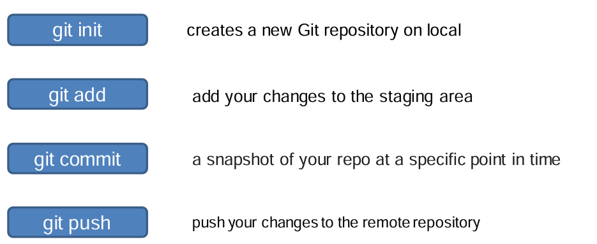
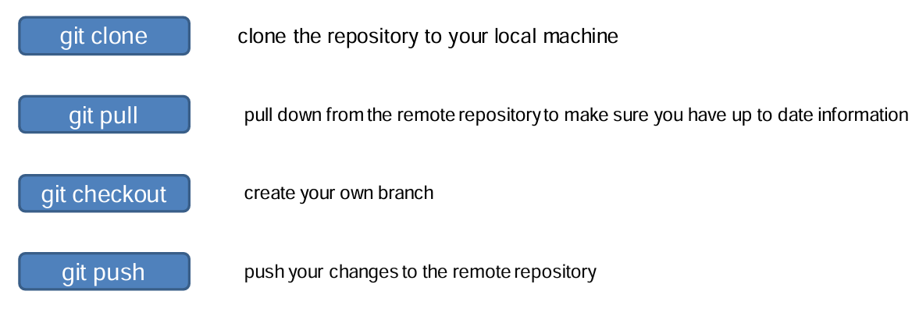
Git Commands

Slide 24
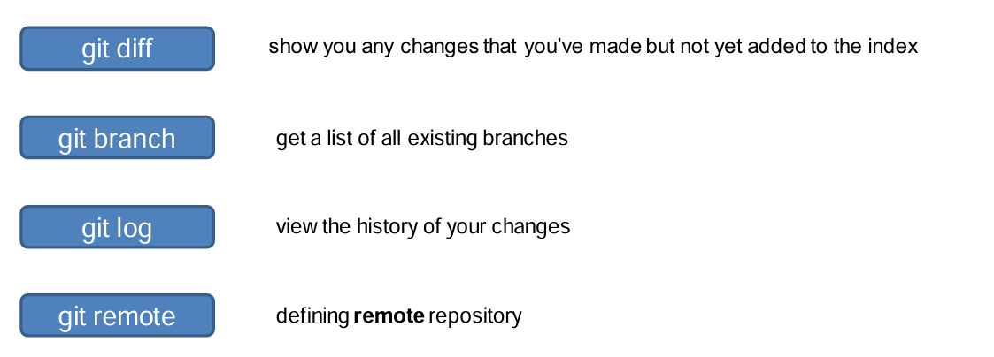
Git Commands

